Slide 1

R for maps & spatial analysis
Anto Aasa
Associate Professor

Slide 2
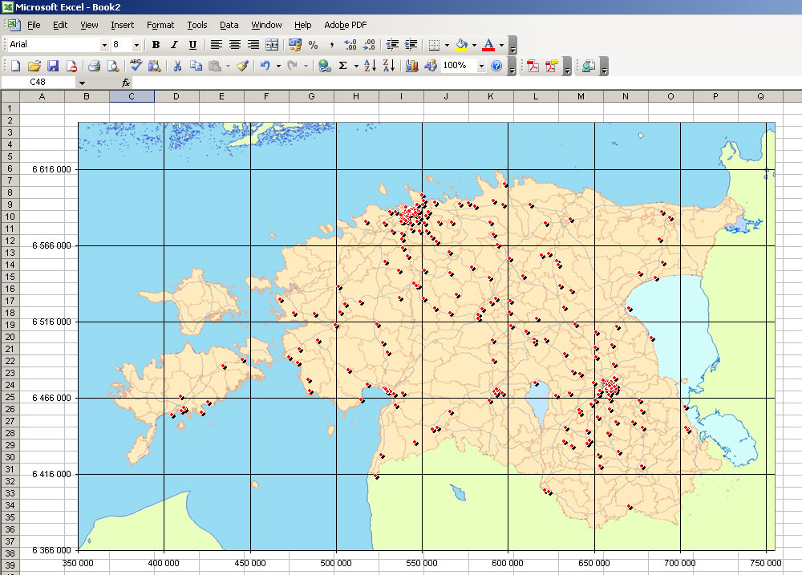
My first automatic map
ca 2001

Slide 3
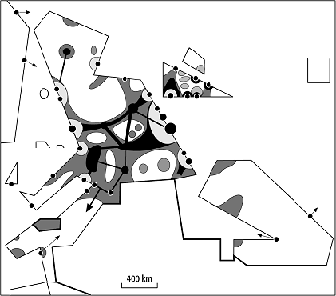
Notes:
Europe’s economy 1646

Slide 4
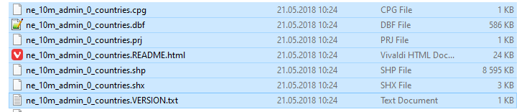
Shape file!

Slide 5
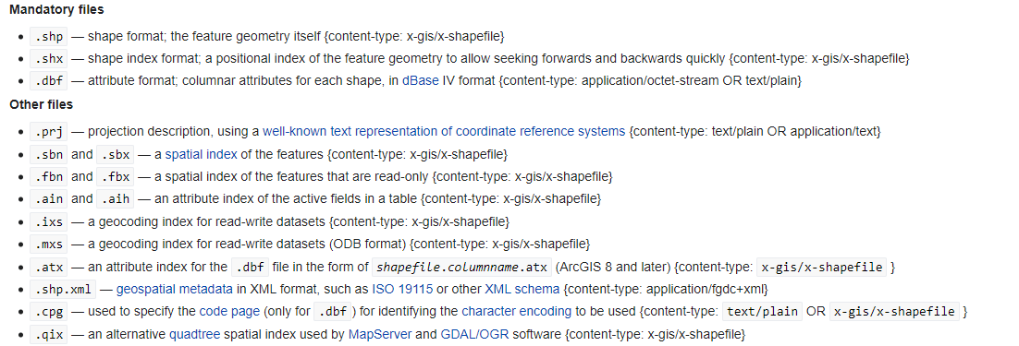
Structure of shp

Slide 6
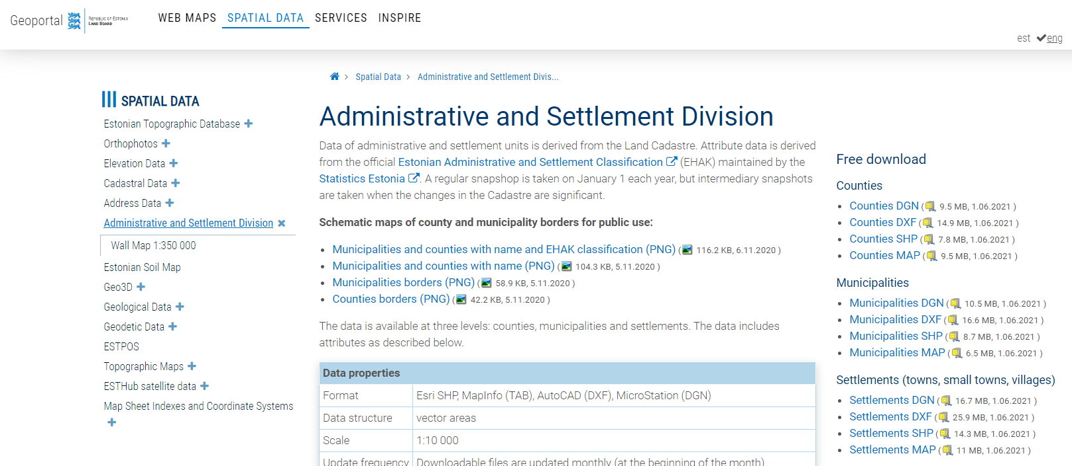
https://geoportaal.maaamet.ee/eng/Spatial-Data/Administrative-and-Settlement-Division-p312.html

Slide 7
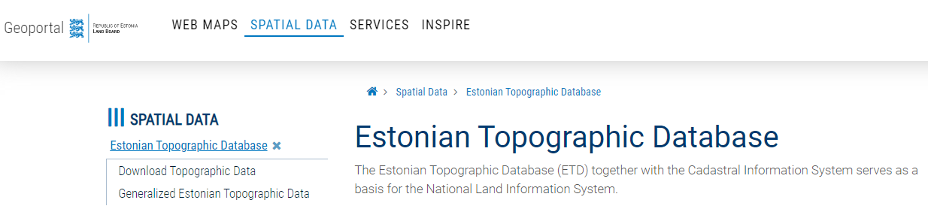
https://geoportaal.maaamet.ee/eng/Spatial-Data/Estonian-Topographic-Database-p305.html

Slide 8
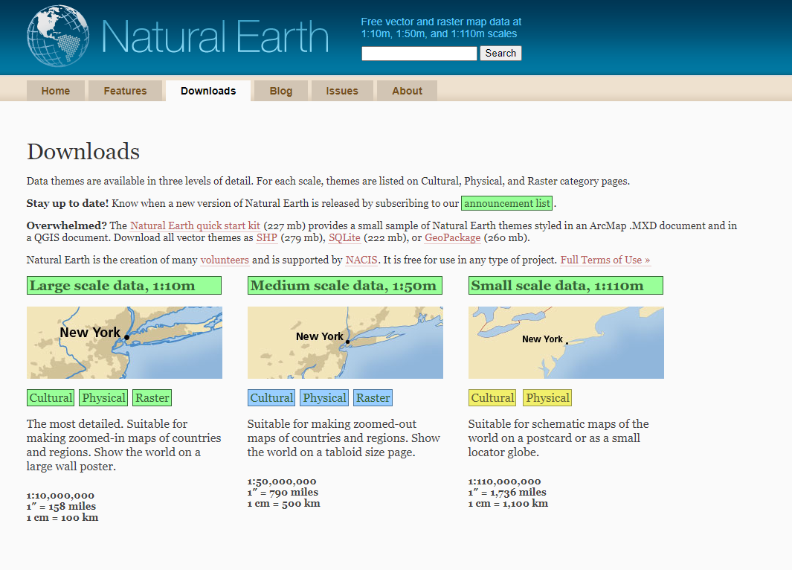
https://www.naturalearthdata.com/downloads/

Slide 9
Spatial objects in R
Visualization
ggplot2
tmap
core R
Analysis
Spatial Data Frame
Simple feature (sf)
Shp
Geopackage
Postigis
Geotiff
…

Slide 10
Import / export spatial data to R
Text (*.csv)
Shapefile (*.shp)
Raster
Geotiff
Rst
…
xml
GeoJSON
…

Slide 11
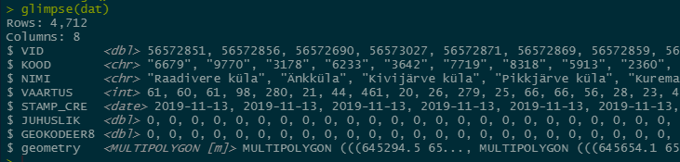
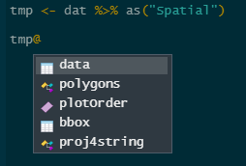
sf:
spatialpolygondataframe:

Slide 12
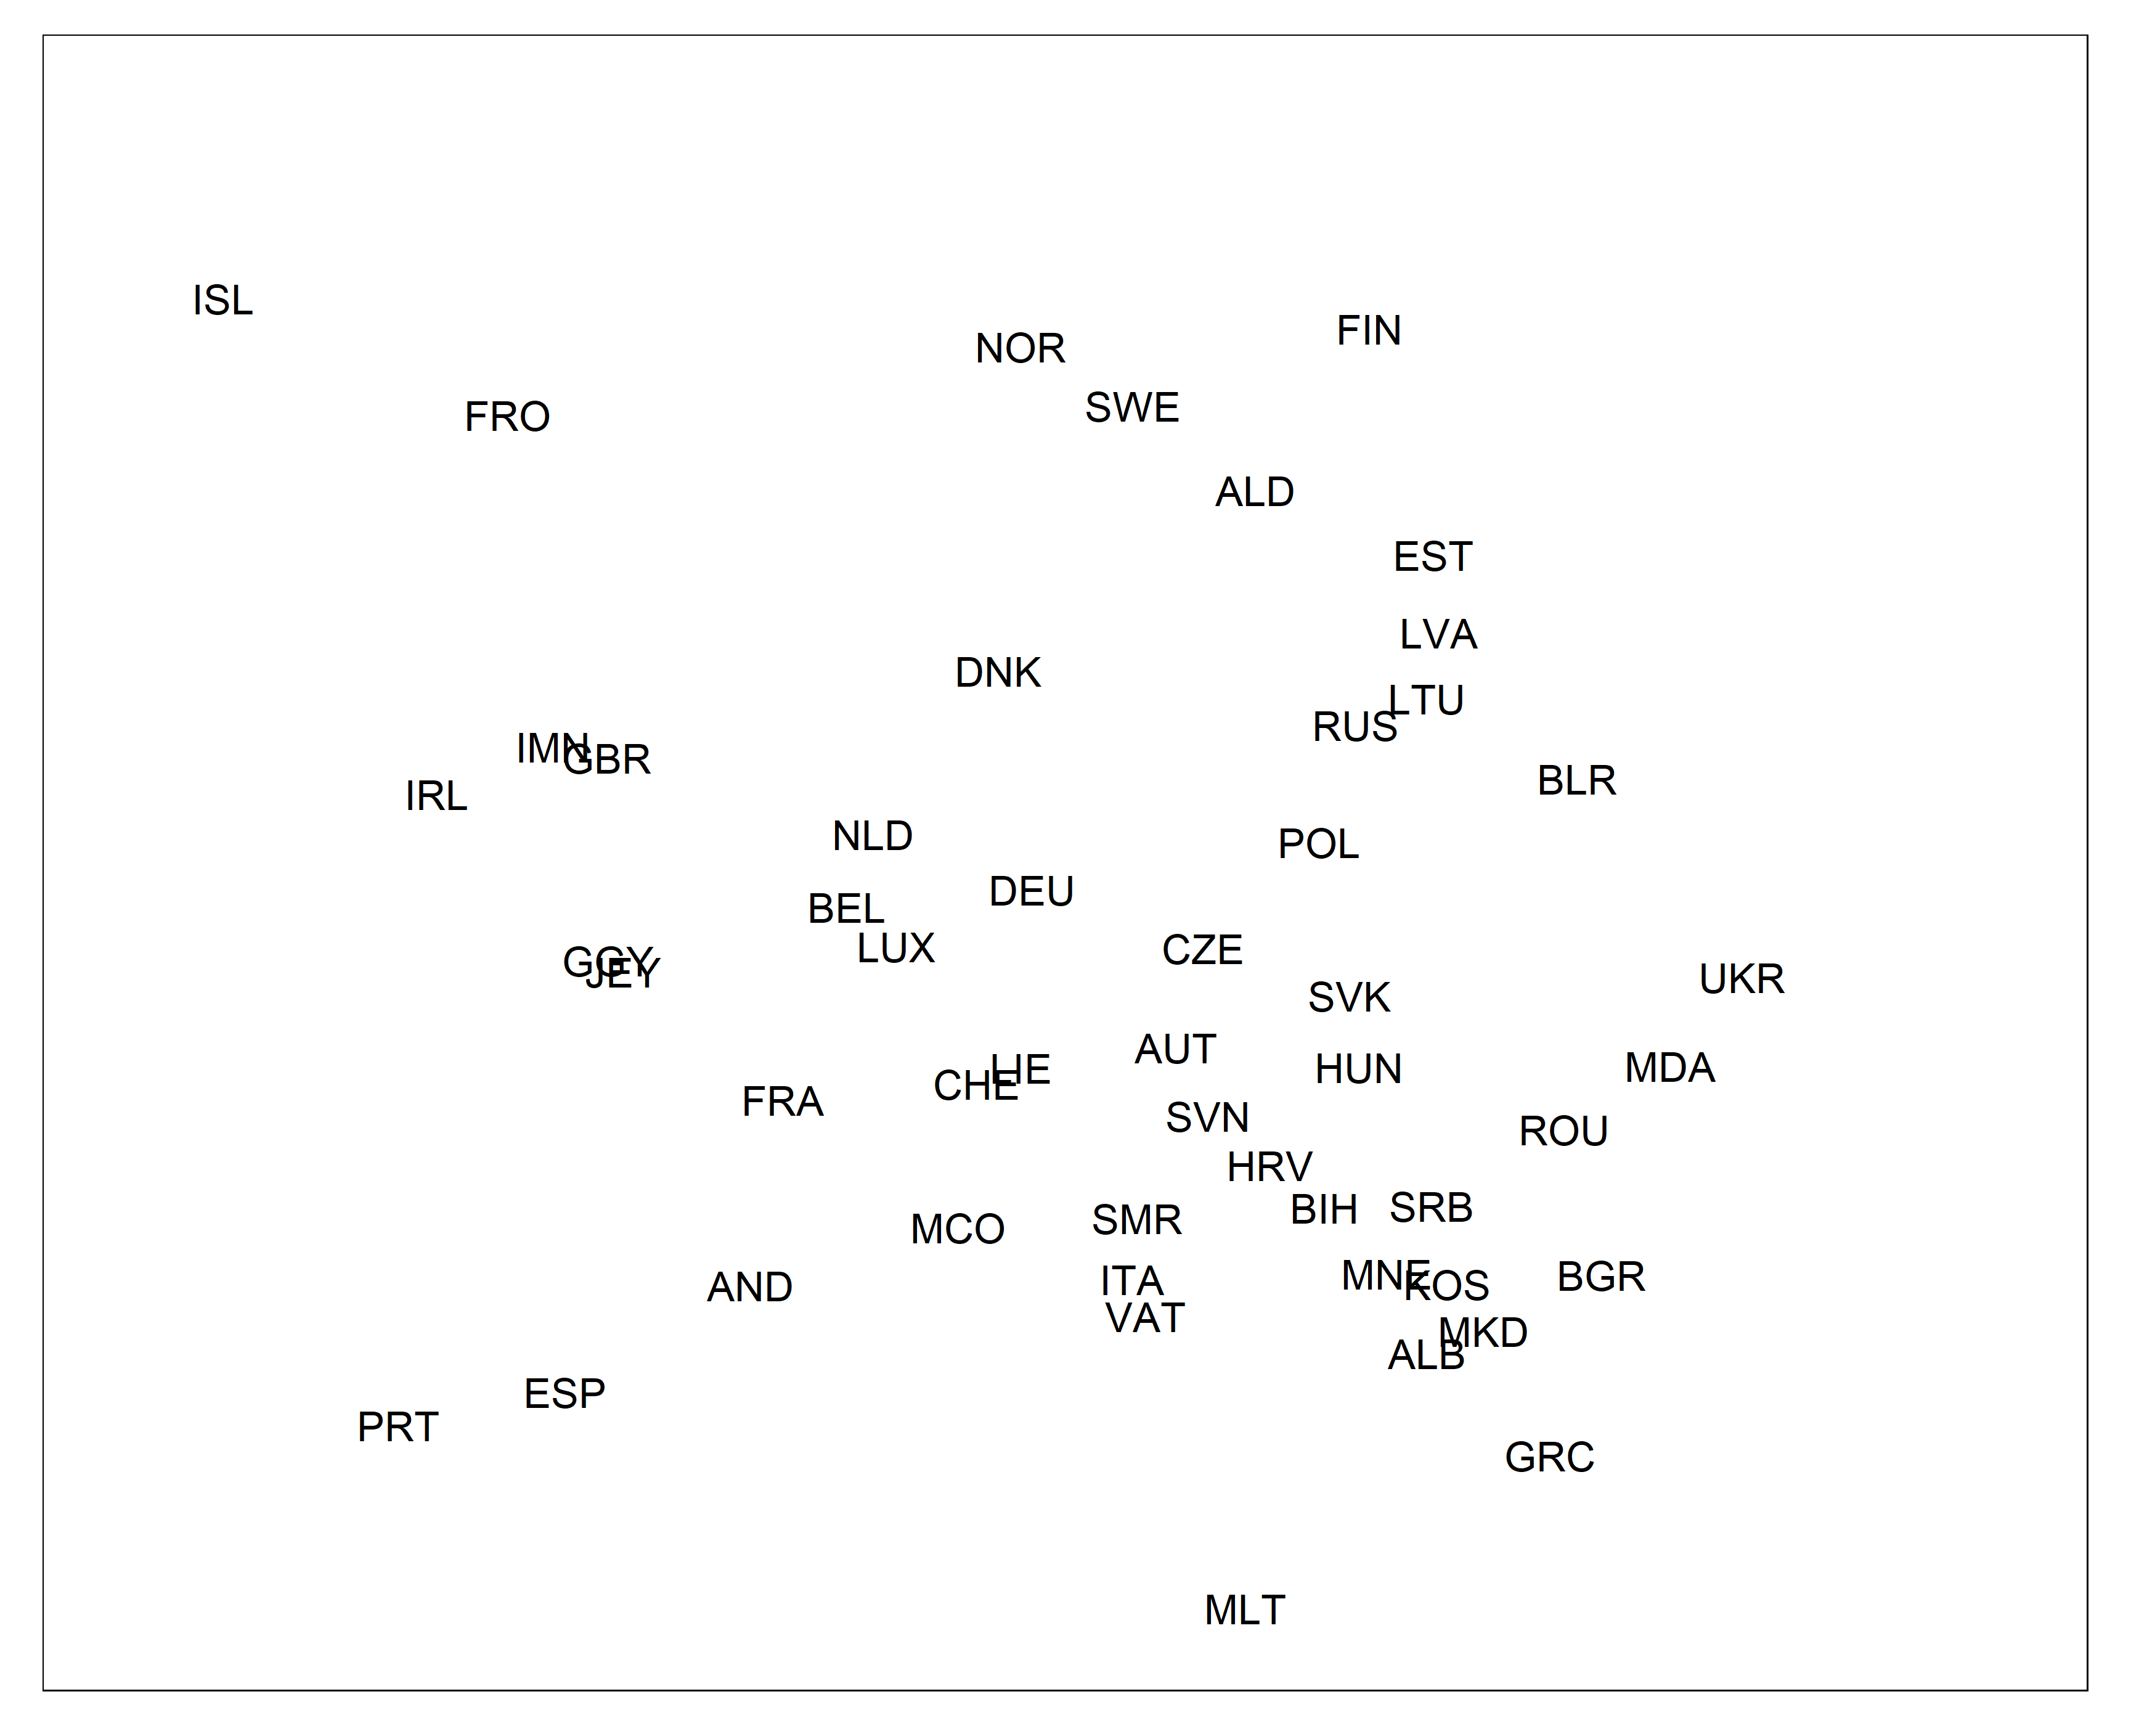
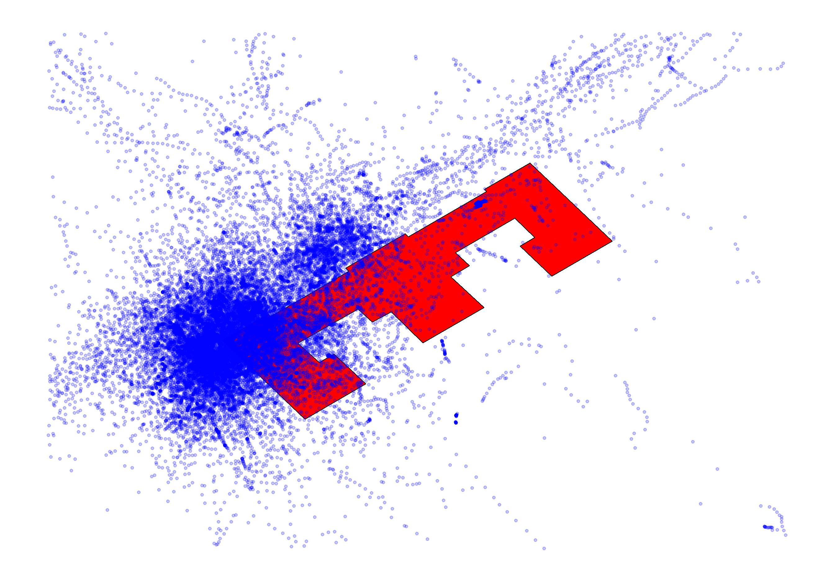
Spatial context
Map scale
Legend
Base map

Slide 13
Projections
CRS (Coordinate Reference System)
Geographical coordinates: WGS-84; epsg:4326
Estonian official CRS: LEST-97, epsg: 3301
https://epsg.io

Slide 14
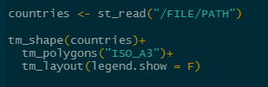
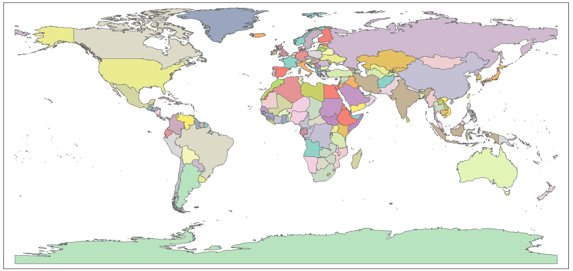

Slide 15
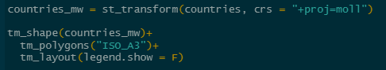
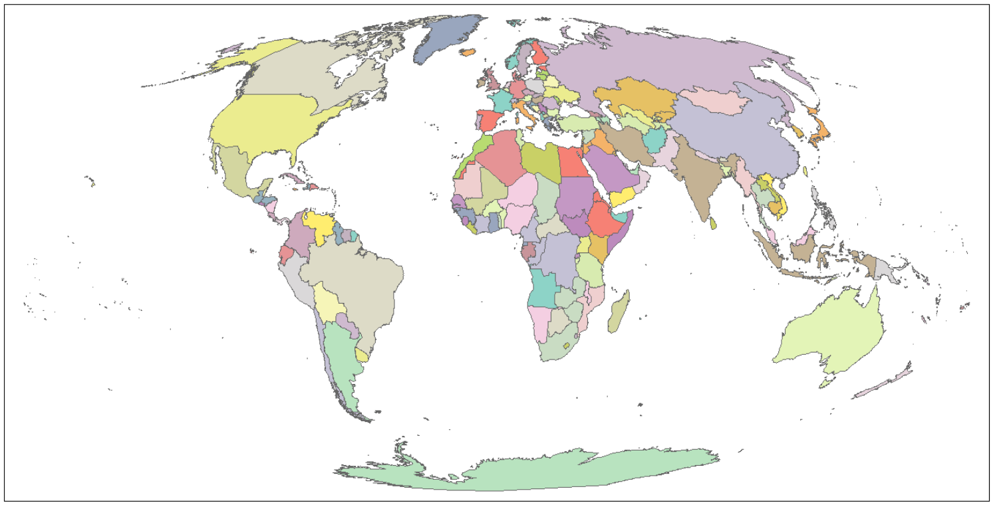

Slide 16
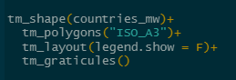
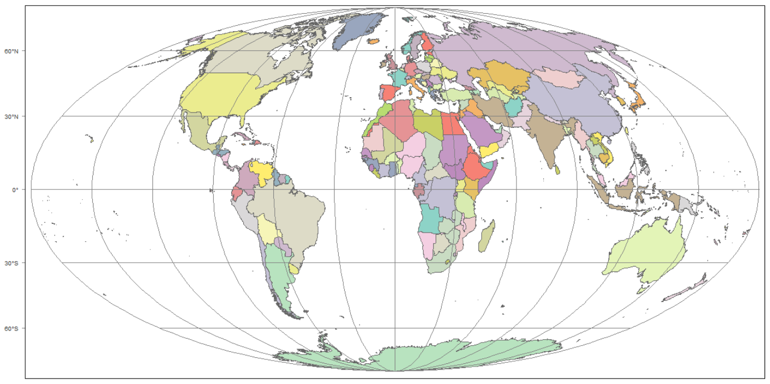

Slide 17
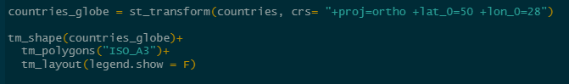
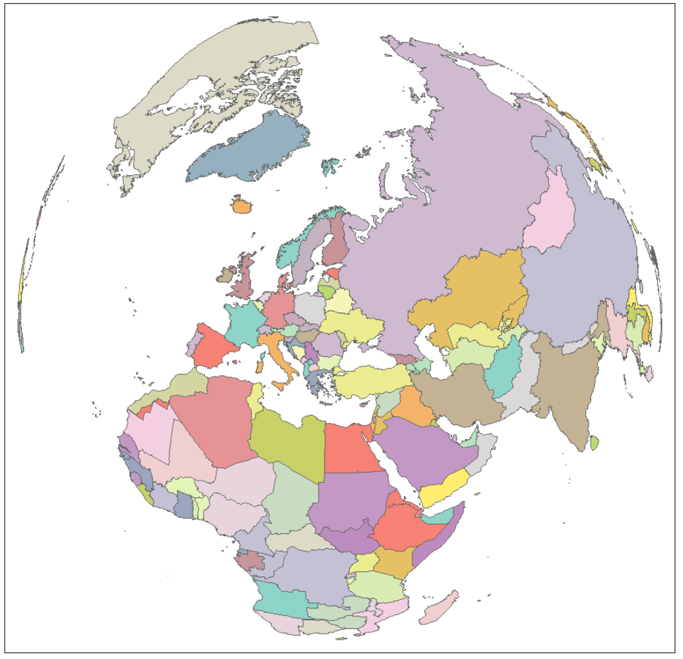

Slide 18
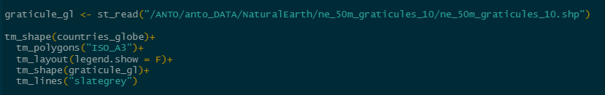


Slide 19
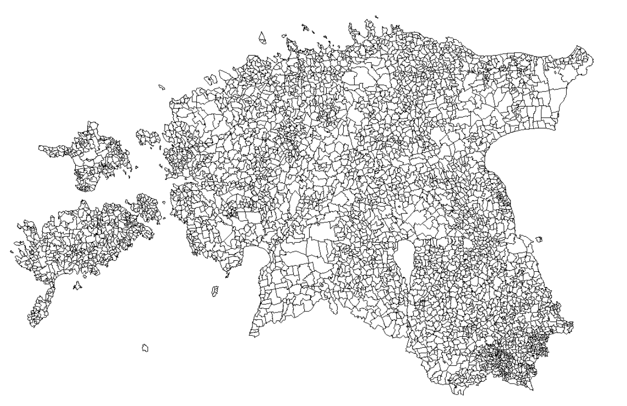
Estonian population

Slide 20
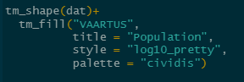
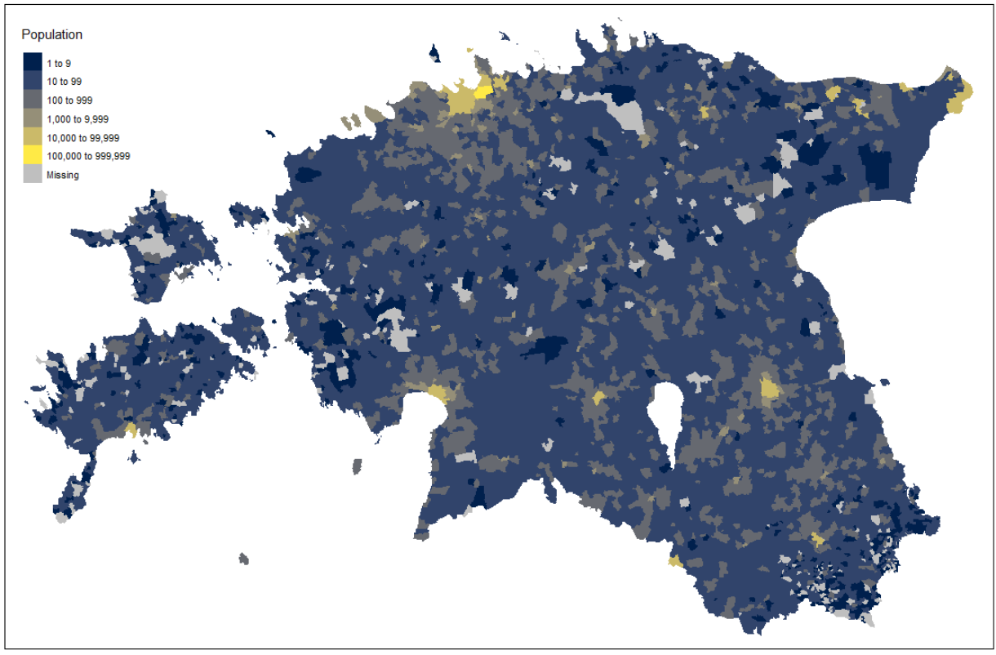

Slide 21
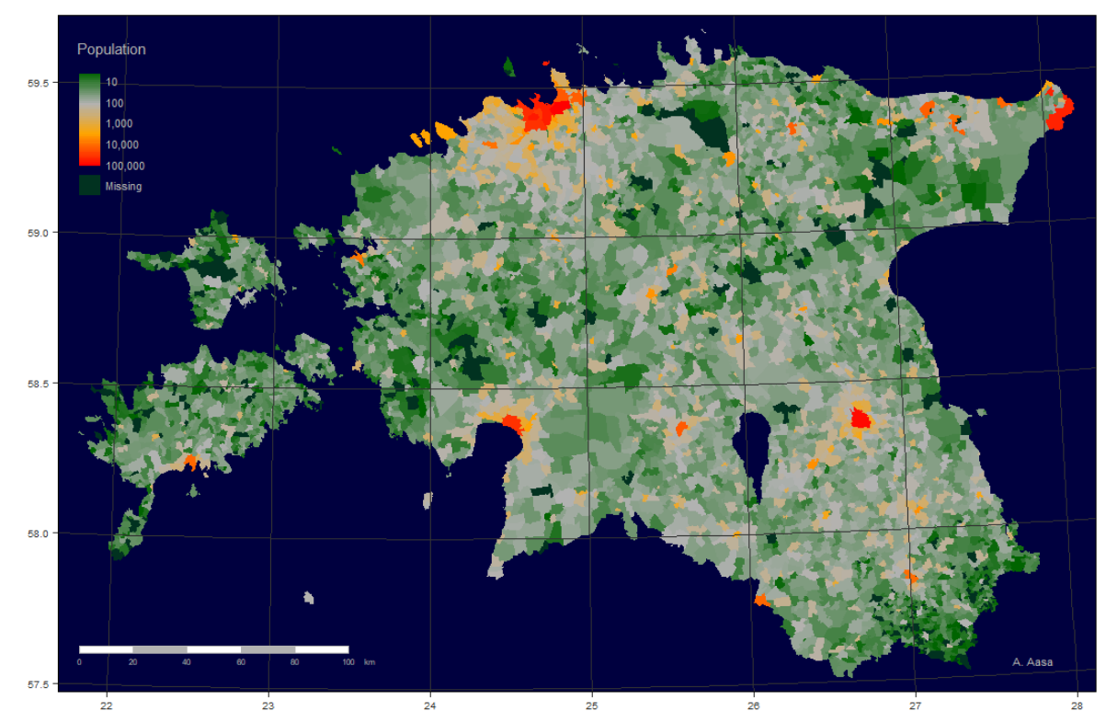

Slide 22
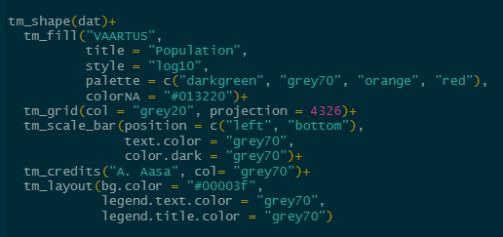

Slide 23
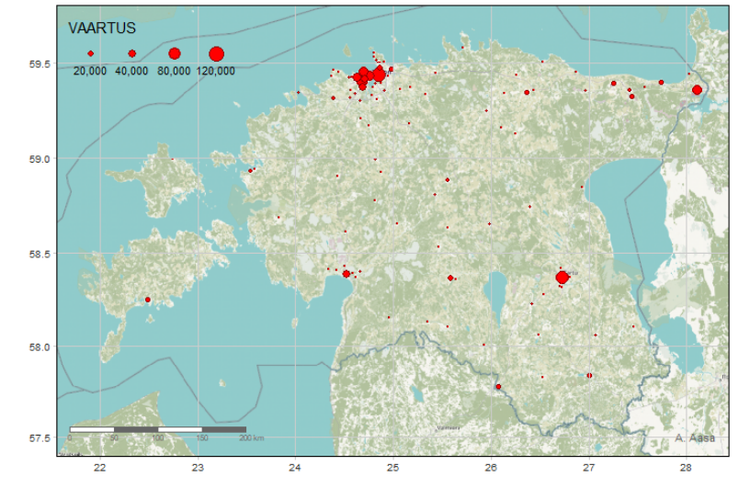
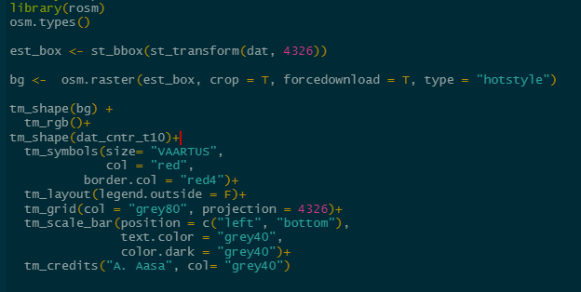
Base map
OSM

Slide 24
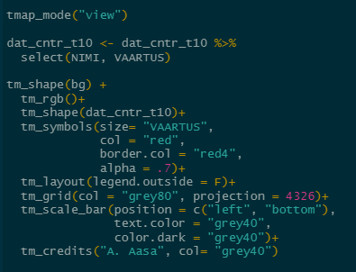
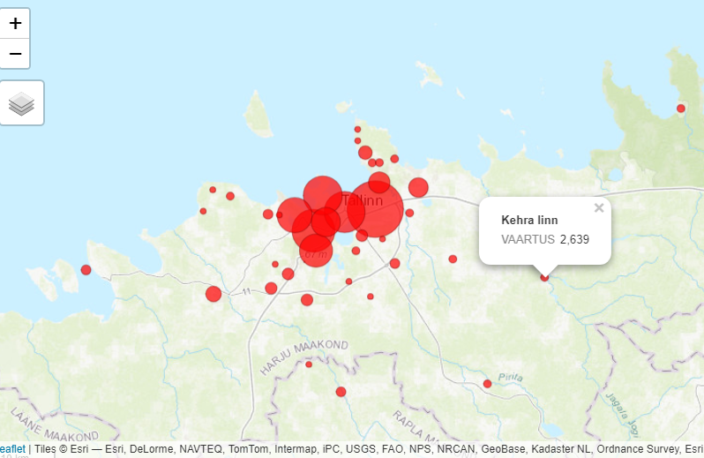
Interactive map

Slide 25
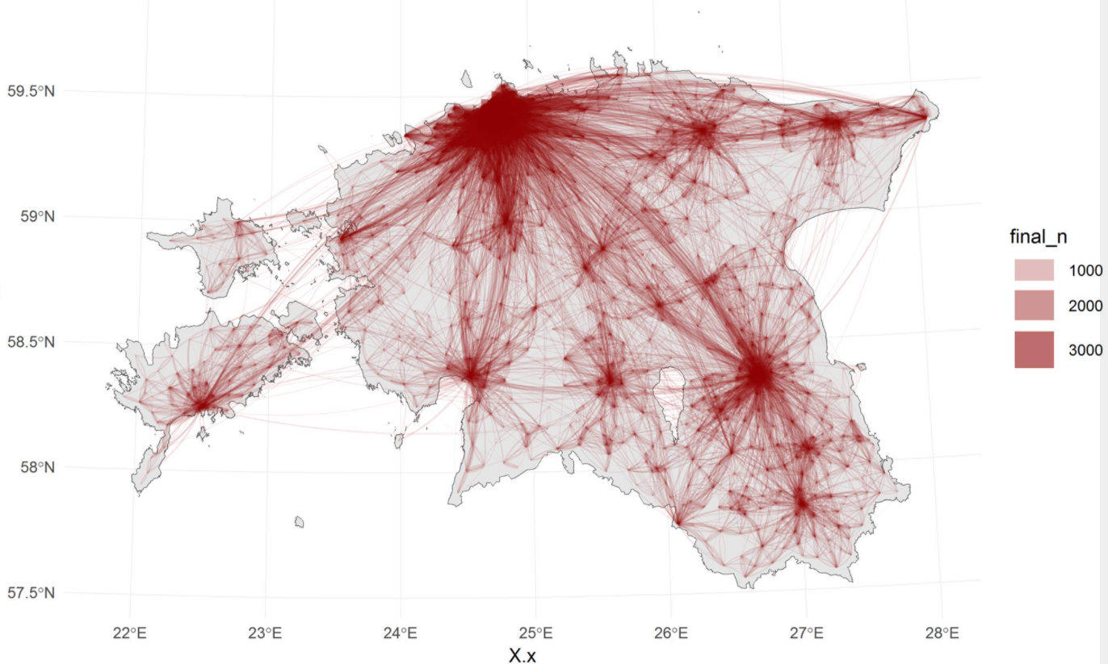
ggplot2
geom_sf()
geom_point()
geom_path()
geom_curve()
geom_polygon()
geom_curve(aes(x = start_x, y = start_y, xend = end_x, yend = end_y))

Slide 26
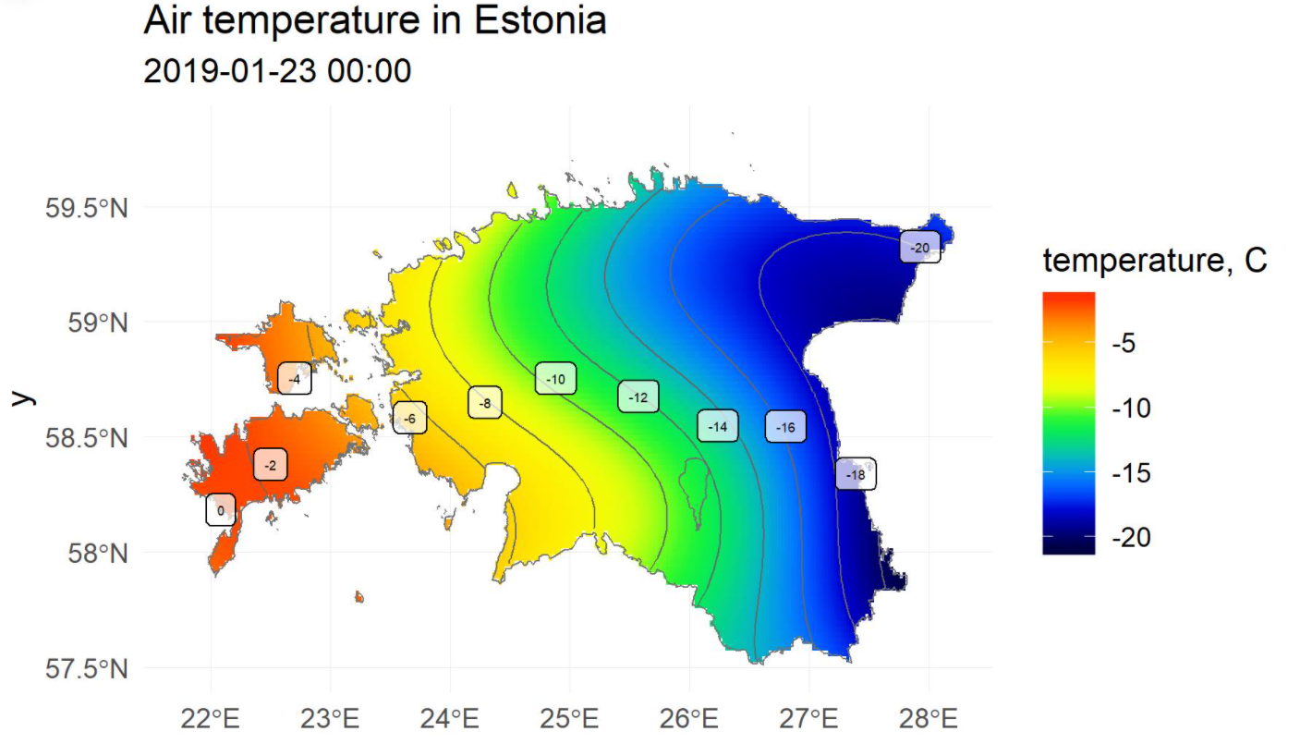
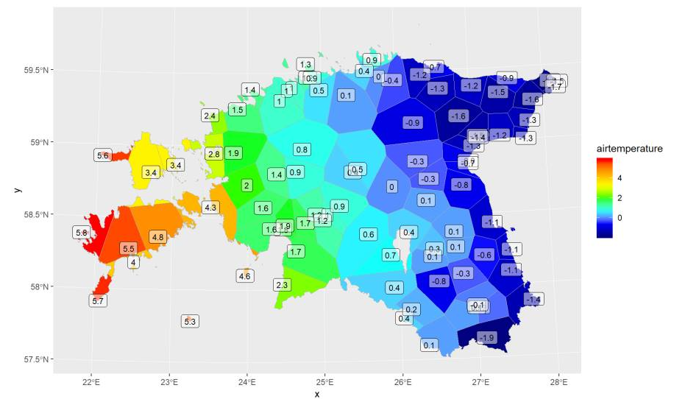
Spatial interpolation

Slide 27
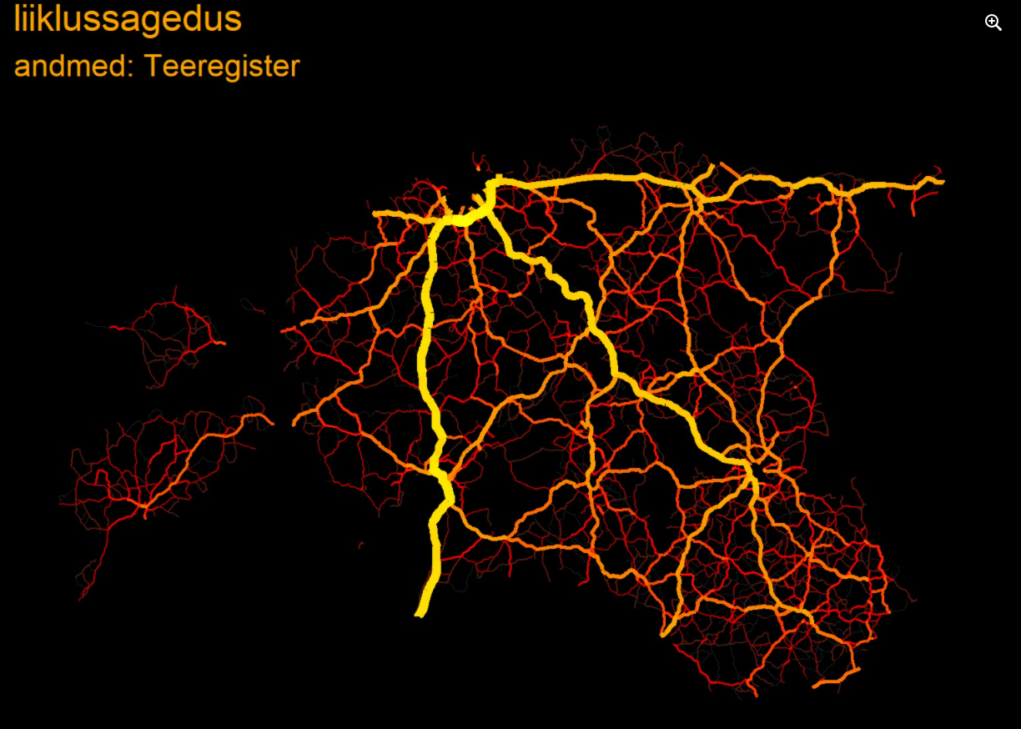
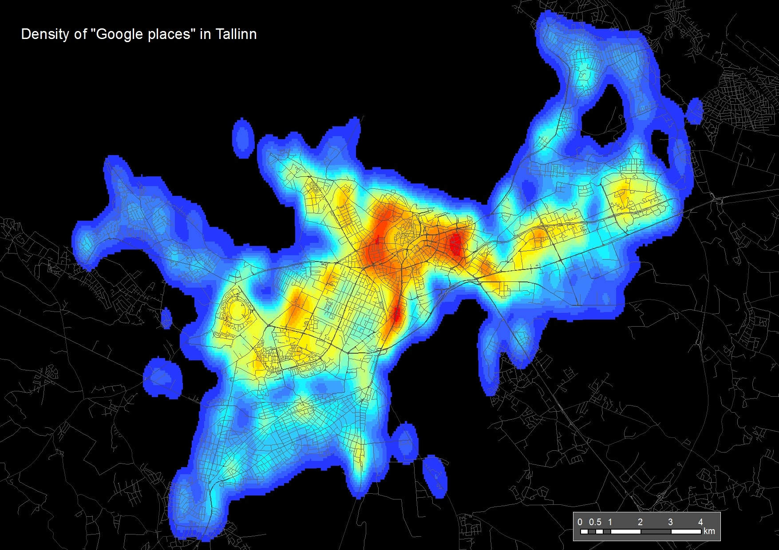

Slide 28
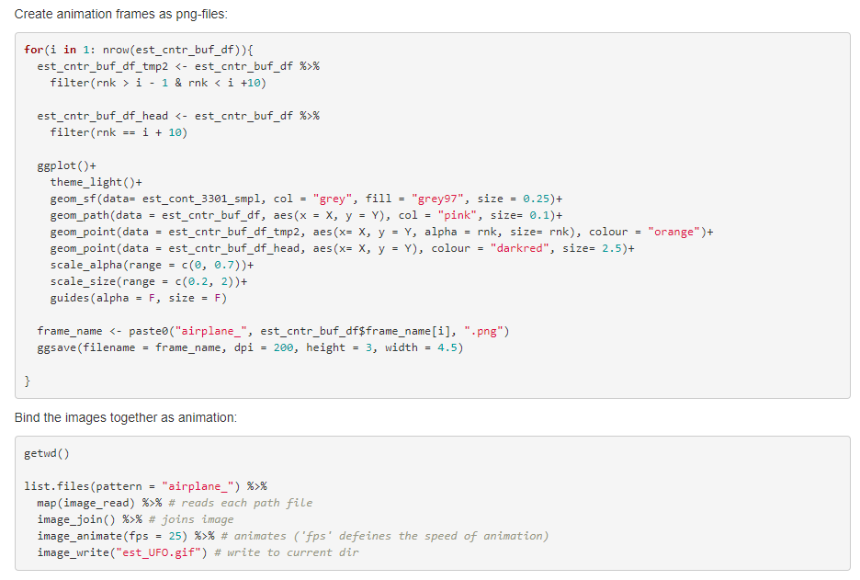
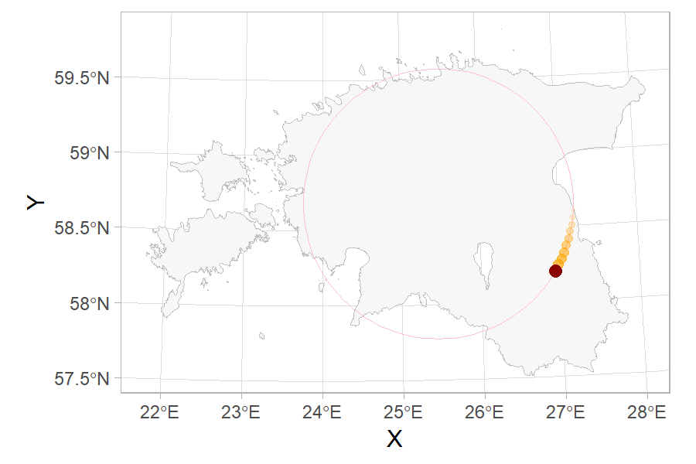
Animations
gganimate
magick
ffmpeg

Slide 29
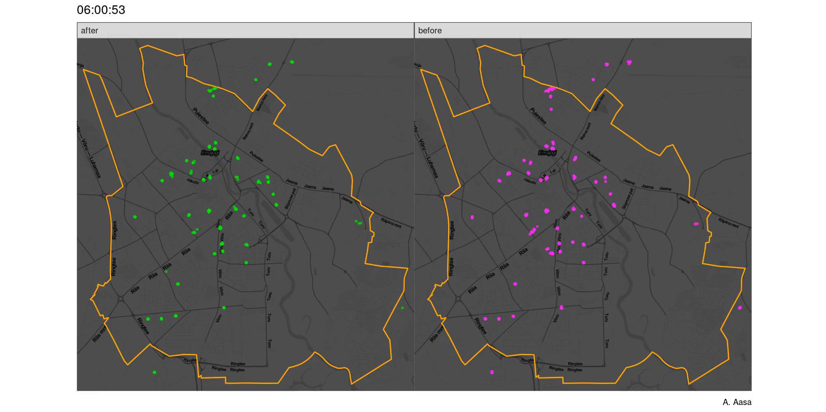
Mobility before and after the virus outbreak

Slide 30
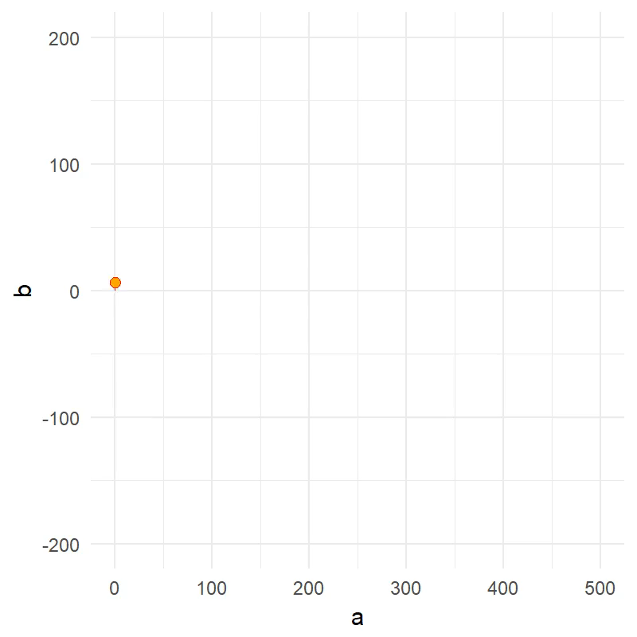
Fools trap

Slide 31
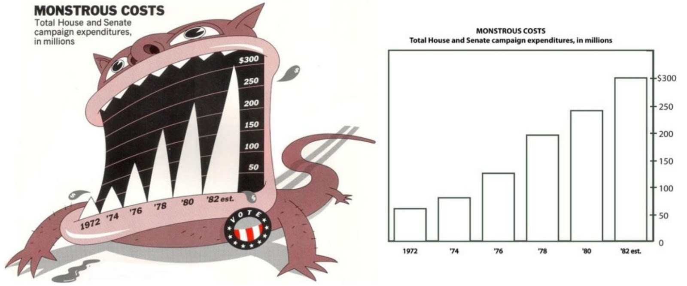
How to impress?
https://eagereyes.org/criticism/chart-junk-considered-useful-after-all

Slide 32
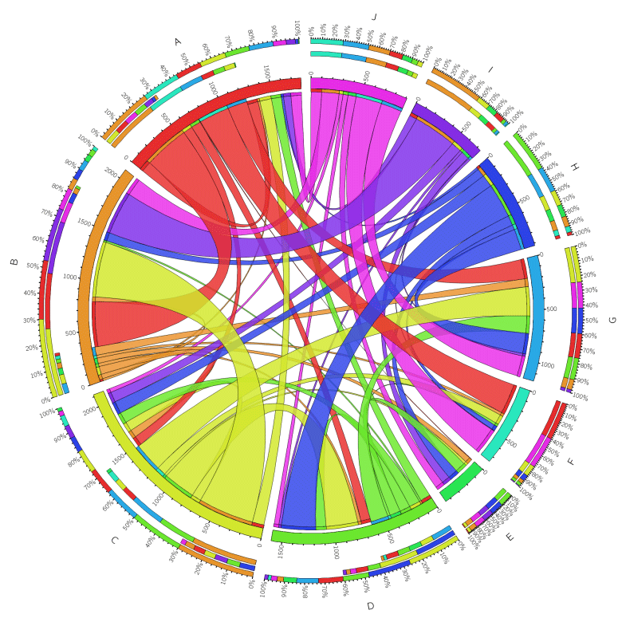
Chord diagram
http://mkweb.bcgsc.ca/tableviewer/samples/

Slide 33
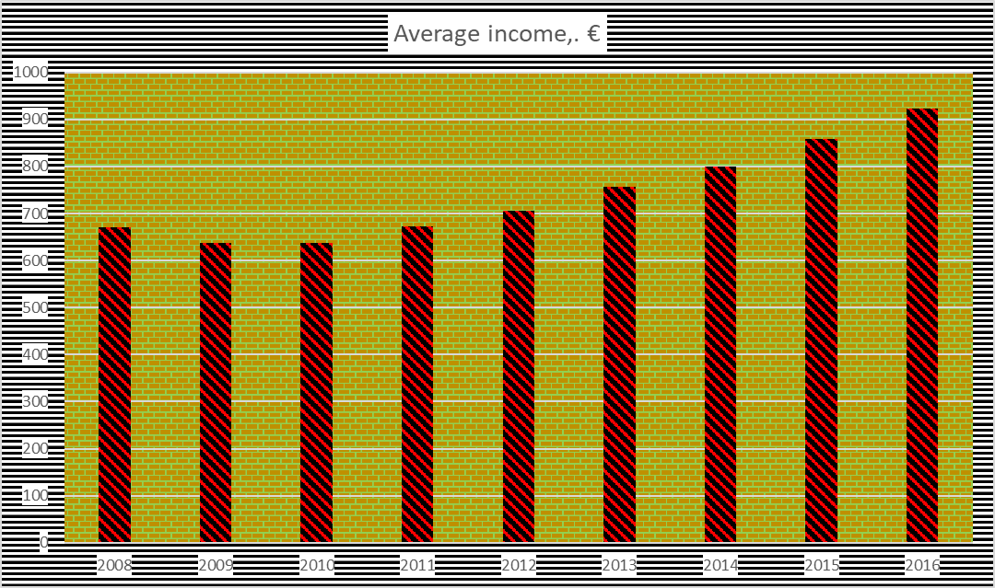
Chart junk

Slide 34
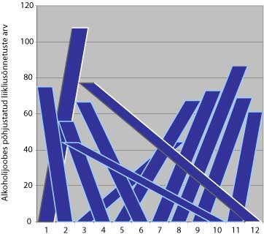
Try to be funny?
Crashes caused by drunk drivers
(readability…)

Slide 35
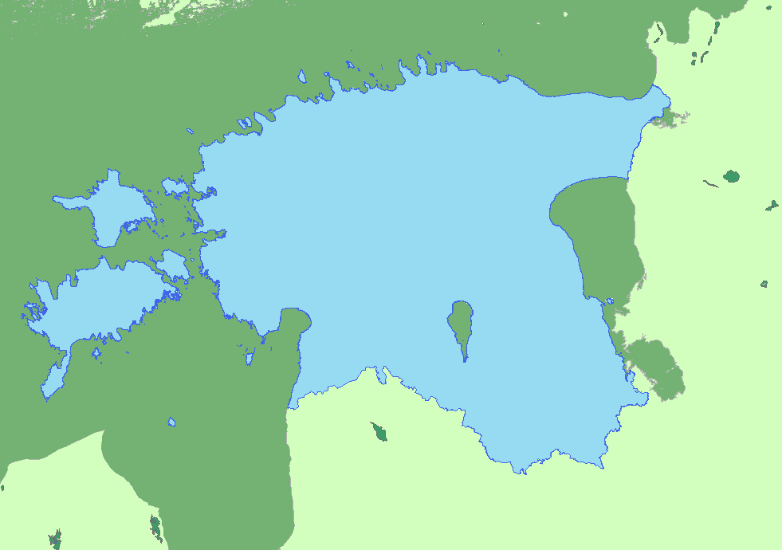
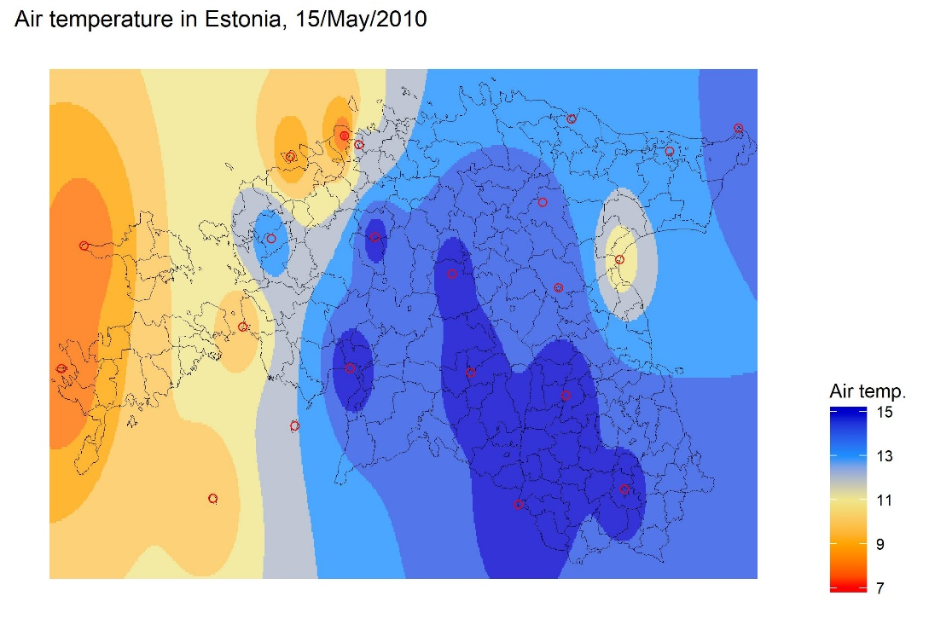
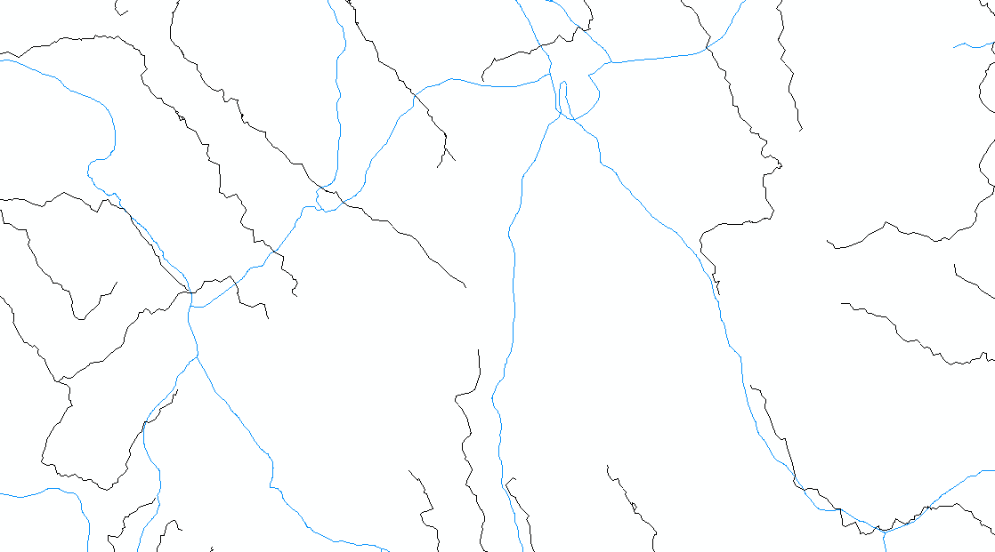
Follow the traditions

Slide 36
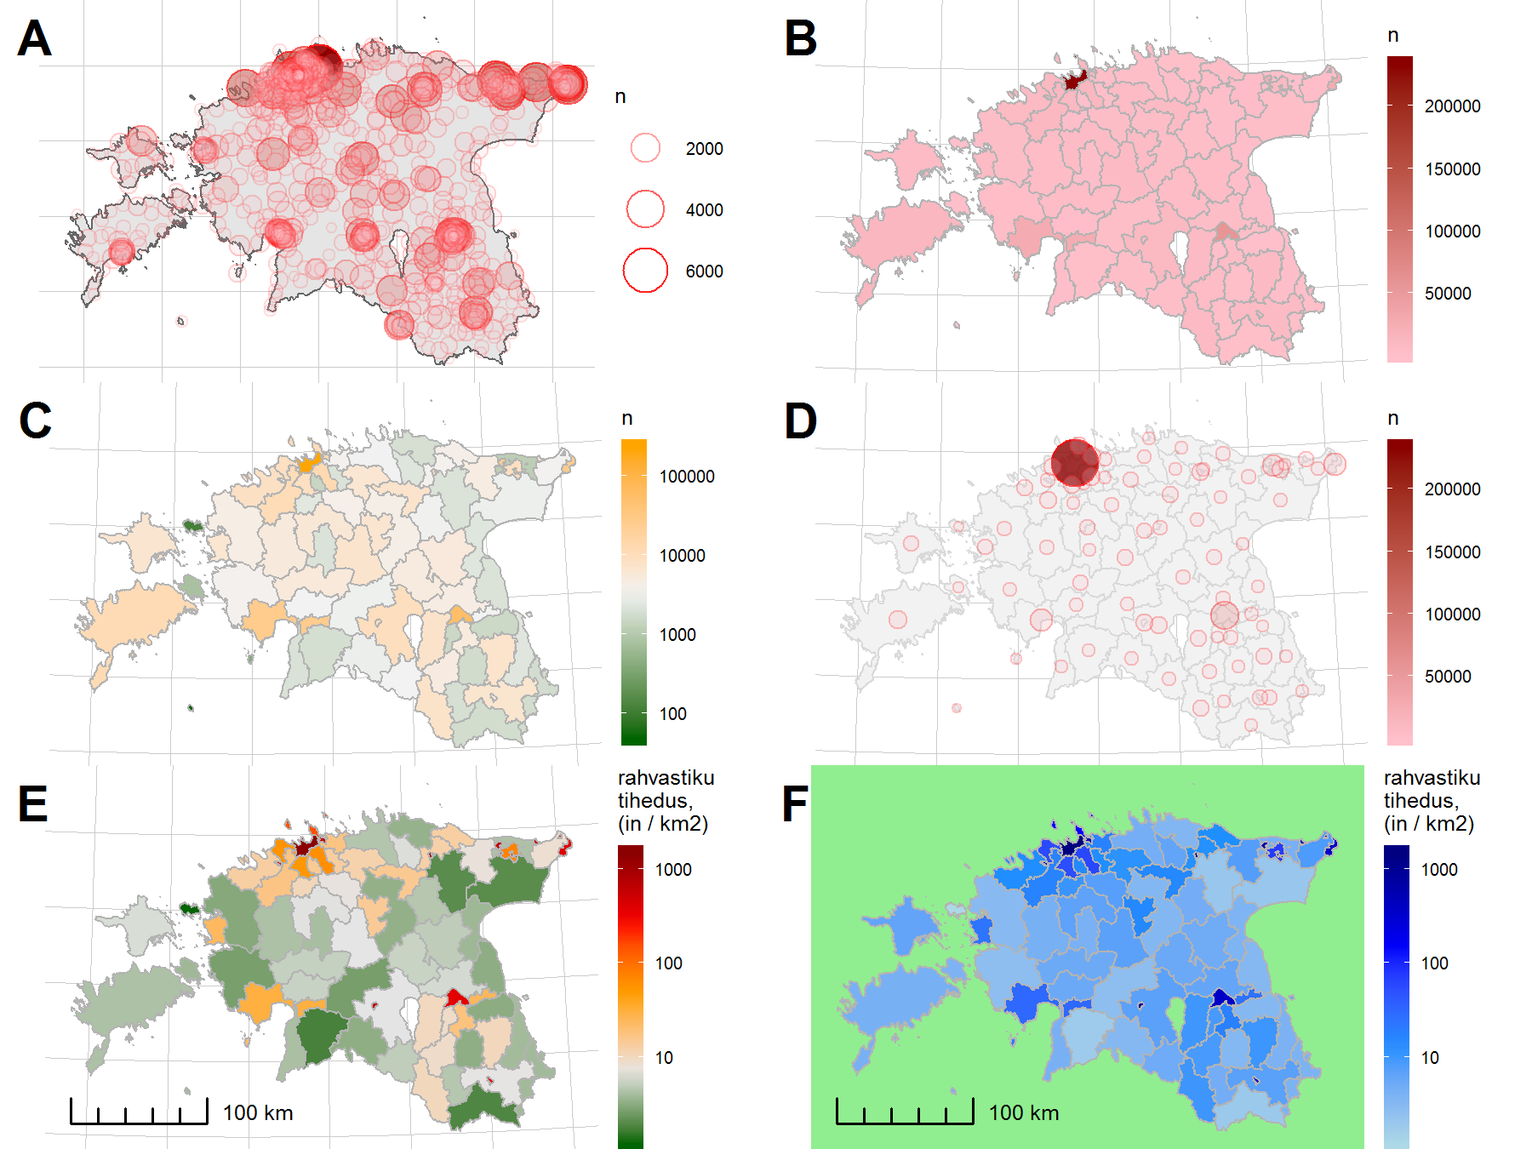
Population map

Slide 37
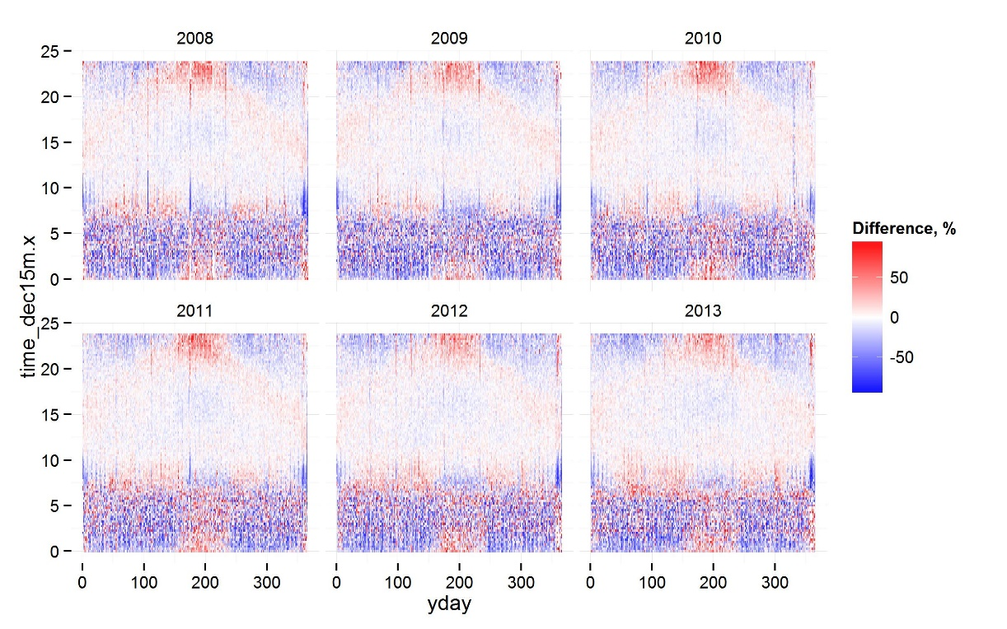
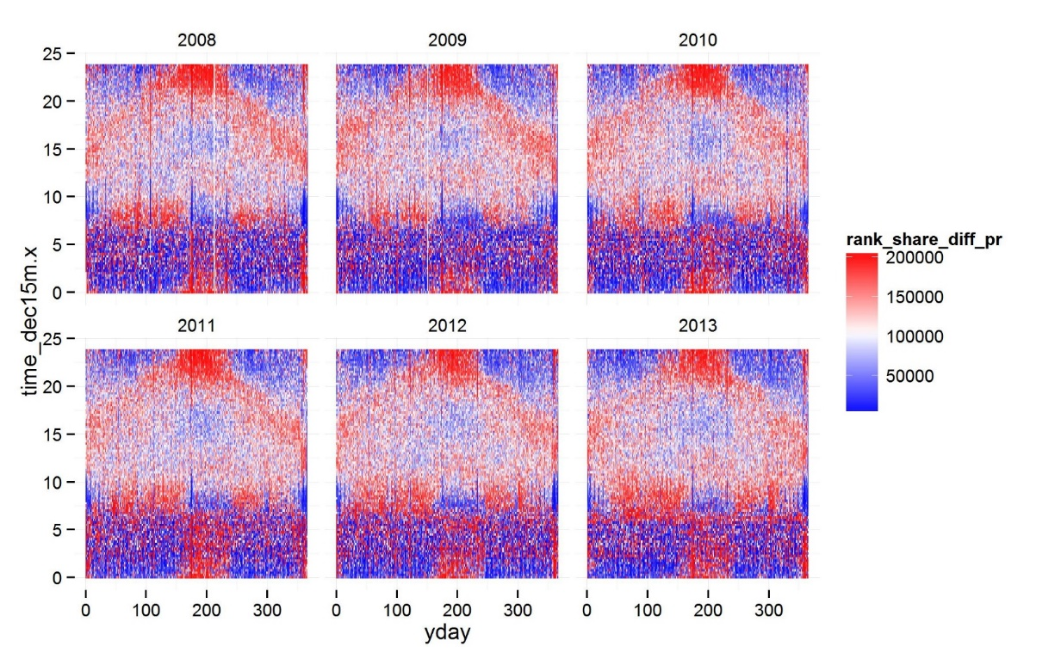
Tuning the picture

Slide 38
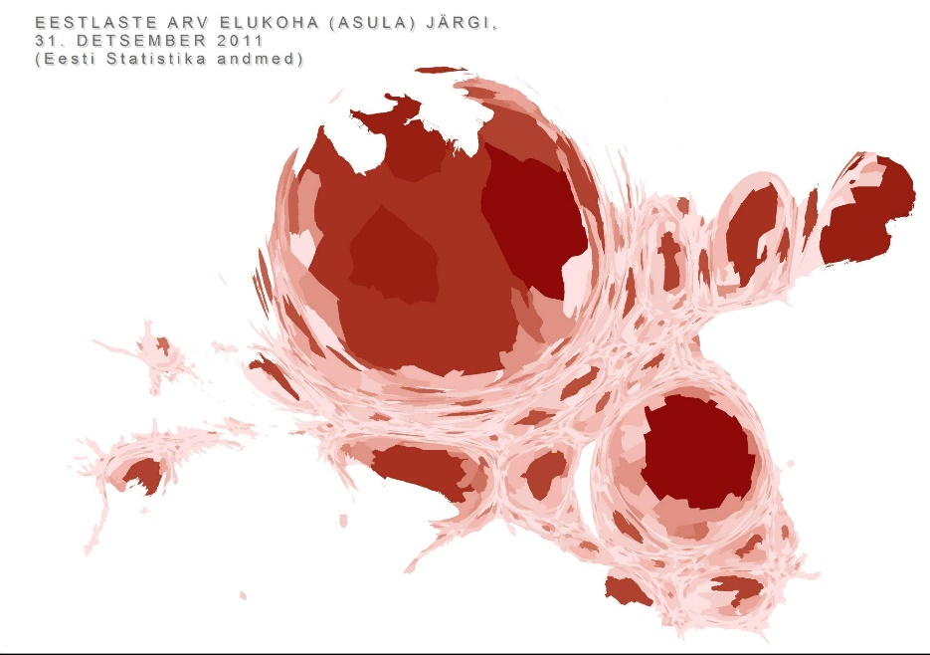
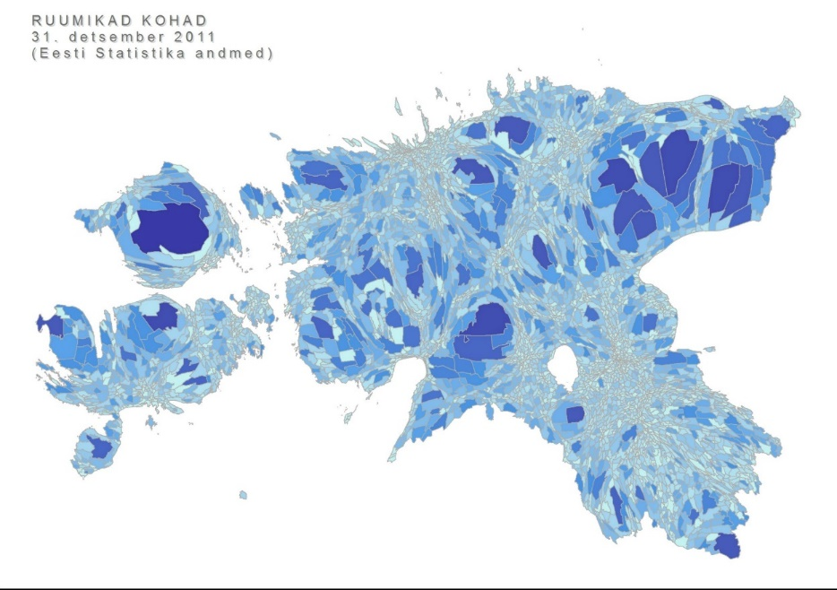
Magic something
FB shares: 4
FB shares: 25
Population
„Empty space“
Notes:
expanded

Slide 39

Out of the Box Thinking
Elevation map of Estonia

Slide 40


What is map?

Slide 41

Bring out the message! Storytelling!
Latvian tourists in Estonia, Feb 2020 – Nov 2020
(data: mobile positioning)

Slide 42





Thank you!
anto.aasa@ut.ee
Read more:
https://aasa.ut.ee/Rspatial/

